Slide 1

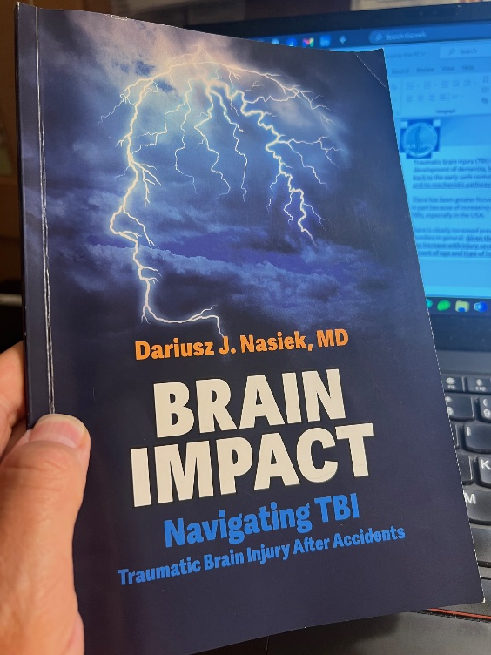
“BRAIN IMPACT – Navigating Traumatic Brain Injury after Accidents” - a new book about evaluation protocols for post-concussion syndrome MESON ESPAÑOL , 08-22-2024
Dr. Dariusz Nasiek, MD
Dr. Niley Shah, MD
Dr. Ravi Tikoo, MD

Slide 2



Slide 3
ALLIED Neurology and Interventional Pain Practice, PC
CENTER OF EXCELLENCE
For Evaluation and Treatment of TBI (Traumatic Brain Injury).

Slide 4


ALLIED Neurology and Interventional Pain Practice, PC
CENTER OF EXCELLENCE
For Evaluation and Treatment of TBI (Traumatic Brain Injury).

Slide 5
MAIN OFFICE:
185 Grand Ave., Englewood, NJ 07631
OTHER OFFICE LOCATIONS: New Jersey:
800 River Dr., Garfield, NJ 07026
60 Evergreen Pl., Suite 902, East Orange, NJ 07018
208 Commerce PI., Elizabeth, NJ 07201 95-08 New York:
Queens Blvd., Rego Park, NY 11374

Slide 6
Newest office location: 7700 River Dr., North Bergen, NJ 07047 Dr. Brian Heller, DC Dr. Anthony Orlando, PT

Slide 7
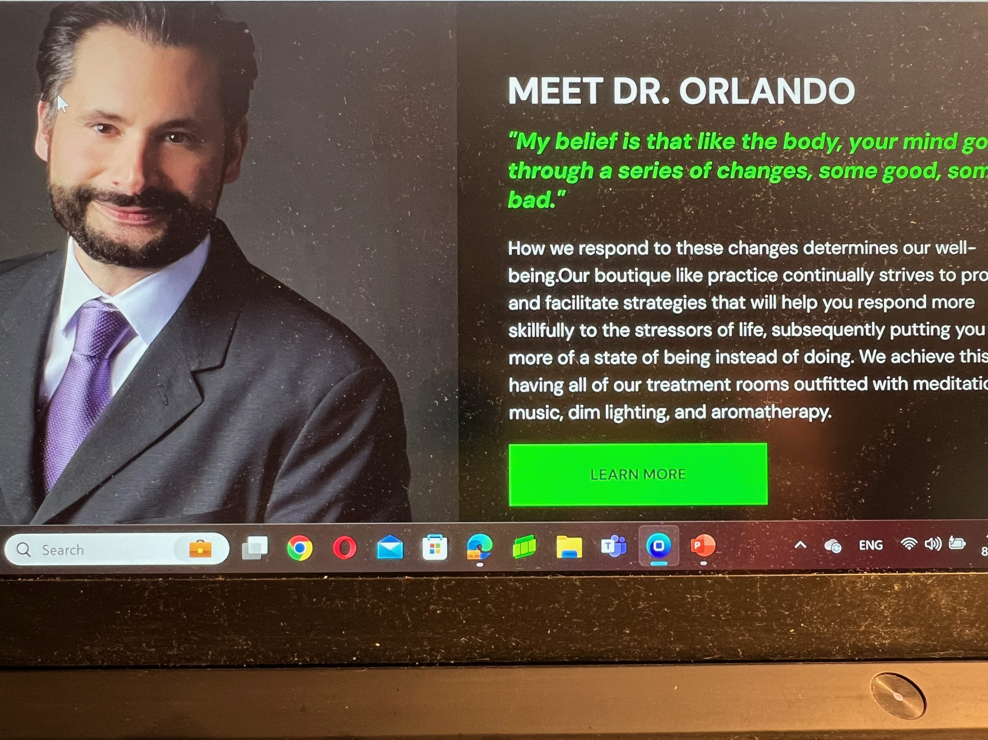

Slide 8


Slide 10
INTRODUCTION every 23 sec. 1.7 million people misunderstood, underreported undertreated “normal” on the outside

Slide 11
TBI MORE COMMON THAN YOU MIGHT THINK 69 millions worldwide 2.8 millions in USA 50,000 lives lost 137 lives per day

Slide 12
Leading Causes: car accidents and falls, sports “concussion crisis” does not discriminate “silent epidemic “

Slide 13
NUMBER OF CASES:1.4M
In the USA, approximately 1.4 million people annually sustain a traumatic brain injury (TBI). Co-occurrence of psychiatric disorders, including post-traumatic stress disorder, complicates recovery.

Slide 14
Any accident can lead to head trauma and then TBI no injury – everything is fine proactive approach – every head injury needs to treated seriously

Slide 16
50% missed in the ER - mission to break the statistics, - change the narrative - empower people with knowledge “mild TBI” action to earlier diagnoses, better treatments, better quality of life

Slide 17
ASKING THE RIGHT QUESTIIONS 1.what was the mechanism of injury? 2.what signs and symptoms have developed? 3. what were the cofundings factors?

Slide 18
INITIAL POST TBI (TRAUMATIC BRAIN INJURY) EVALUATION Step 1. Establish Plausible Injury Mechanism. ﻿﻿Ask the patient to describe the sequence of events surrounding the injury. ﻿﻿ Listen carefully and query as necessary for a concussive force (e.g., Did your head jolt back and forth?) and its intensity (e.g., From what height did you fall?). ﻿﻿ Distinguish the patient's personal memories Step 2. Query Signs and Symptoms. Determine whether the patient's mental status was altered immediately after the impact. Example questions: ﻿﻿- Do you remember the impact and moments just after? Step 3. Rule Out Confounding Factors Check whether factors other than brain injury can account for the acute alteration in mental status. Example questions: ﻿﻿ - Were you drinking alcohol or using drugs just before the accident? ﻿﻿

Slide 19
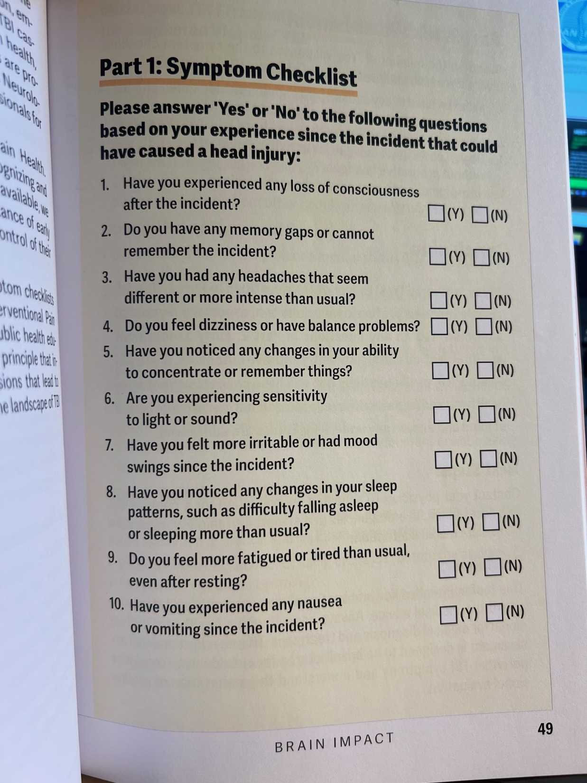

Slide 20
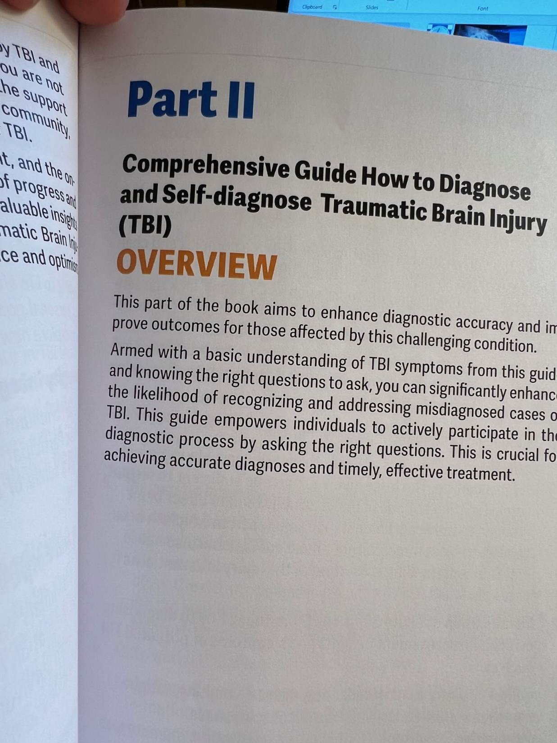

Slide 21
ASKING THE RIGHT QUESTIIONS 1.what was the mechanism of injury? - car accident - fall - sport -speed -height how was the energy transferred to the head and was the brain affected as the result??

Slide 22
ASKING THE RIGHT QUESTIIONS 2.what signs and symptoms have developed? Key signs: H/A, dizziness, confusion, memory, N/V, sensitivity, balance, mo PHYSICAL, COGNITIVE,EMOTIONAL

Slide 23
ASKING THE RIGHT QUESTIIONS 3. what were the confounding factors? Co-morbidities, medications, surgeries Alcohol, drug

Slide 25
1. Traumatic Brain Injury (TBI) and its prevalence 2. Long-term implications such as increased dementia risk and decreased life expectancy post-TB

Slide 26
TBI and Dementia Risk 1. The established link between TBI and dementia risk, supported by multiple studies​. 2. Recent findings indicating a 4x increase in dementia risk.

Slide 27
TBI and Dementia CTE Alzhemers “forgotten TBI” “cognitive reserve”

Slide 28
DEMENTIA: x2 x4 Traumatic brain injury (TBI) may pose an increased risk for dementia decades after the injury occurs. - Dementia risk is 2.4-fold higher in patients with mild TBI - Dementia risk id 3.8- fold higher in moderate-to-severe TBI

Slide 29
Life Expectancy Post-TBI 1. Discussion on studies showcasing the decrease in life expectancy following TBI​. 2. The 9 years decrease in life expectancy.

Slide 30
TBI and life expectancy: “domino effect” seizures,infections, sleep disorders “invisible burder” H/A, fatigue,mood, mental health - suicide

Slide 31
LIFE EXPECTANCY DECREASED: 9 years Moderate-to-Severe TBI: A Chronic Disease That Leads to Medical and Psychiatric Disorders, as Well as Dementia Barnes DE et al. Neurology 2015. Jun TBI is associated with higher prevalence of diabetes, hypertension, myocardial infarction, cerebrovascular disease, depression, and post-traumatic stress disorder. Regardless of type of TBI, more veterans with TBI developed dementia than those without TBI, at an average of 2.1 years earlier. Among veterans without dementia, those with TBI died 2.3 years earlier than those without.

Slide 32
ALLIED Neurology and Interventional Pain Practice, PC
CENTER OF EXCELLENCE
For Evaluation and Treatment of
TBI (Traumatic Brain Injury).

Slide 33
TBI is a “chronic disease” with increase in psychiatric morbidity, medical morbidity, mortality and dementia.

Slide 34
CONCUSSION FINAL DIAGNOSIS: Head trauma injury resulting in concussion of the brain and post-concussion syndrome

Slide 35
CONCUSSION PERMANENCY: A concussion of the brain results in permanent and cumulative damage to the axons in the cerebrum and midbrain. This damage renders the brain liable to devastating consequences in the event of future head trauma and the inevitable consequence of the aging process. Having sustained a concussion, patient has an increased likelihood of developing dementia and Parkinson’s disease as aging progresses. Patient’s life span is decreased.

Slide 36
THANK YOU, DARIUSZ J. NASIEK, MD dnasiek@gmail.com cell: 646-431-8560

Slide 37
THANK YOU, DARIUSZ J. NASIEK, MD dnasiek@gmail.com cell: 646-431-8560

Slide 38


Slide 39
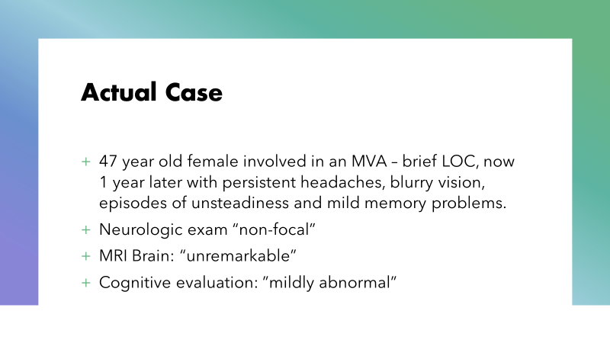

Slide 40
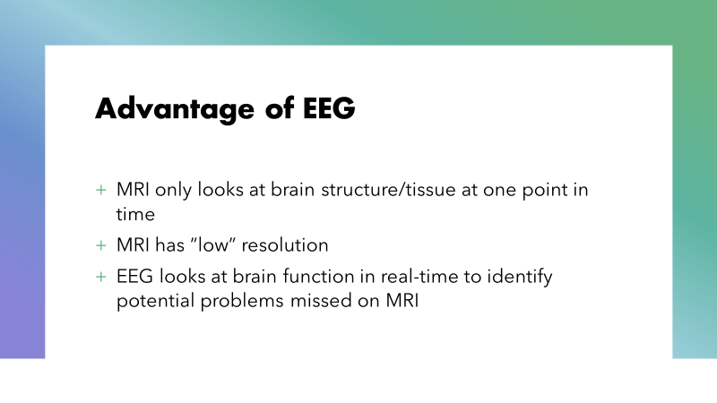

Slide 41


Slide 42
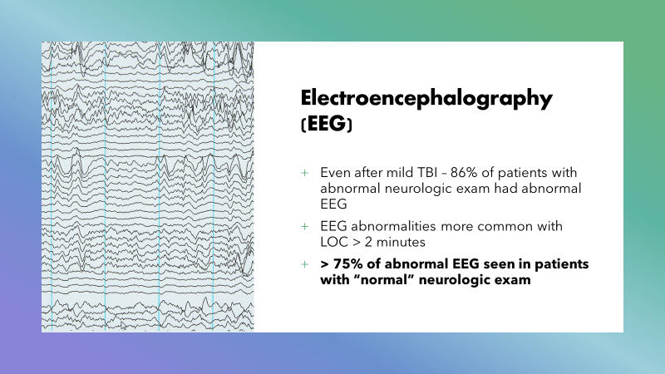

Slide 43


Slide 44
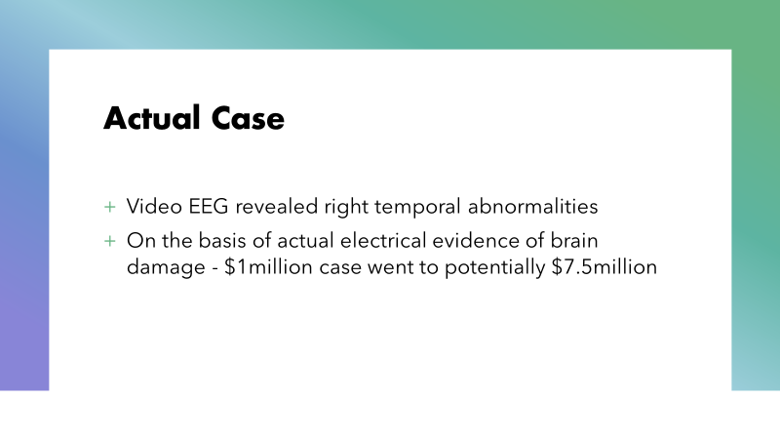

Slide 45

















Slide 46


Slide 47


Home Video EEG Monitoring

Slide 48
Home Video EEG Monitoring

Slide 50
Traumatic brain injury (TBI) is a risk factor for the later development of dementia, but although the evidence dates back to the early 20th century, the nature of any association and its mechanistic pathways remain unclear. There has been greater focus on this subject over recent years, in part because of increasing reports around sports related TBIs, especially in the USA. There is clearly increased prevalence of neurodegenerative disorders in general. Given the evidence that dementia risk may increase with injury severity and frequency, a detailed account of age and type of injury is essential.

